Slide 1
NLP: Sentiment Analysis
Analyzing Product Sentiments from Tweets
Sung Bae

Slide 2
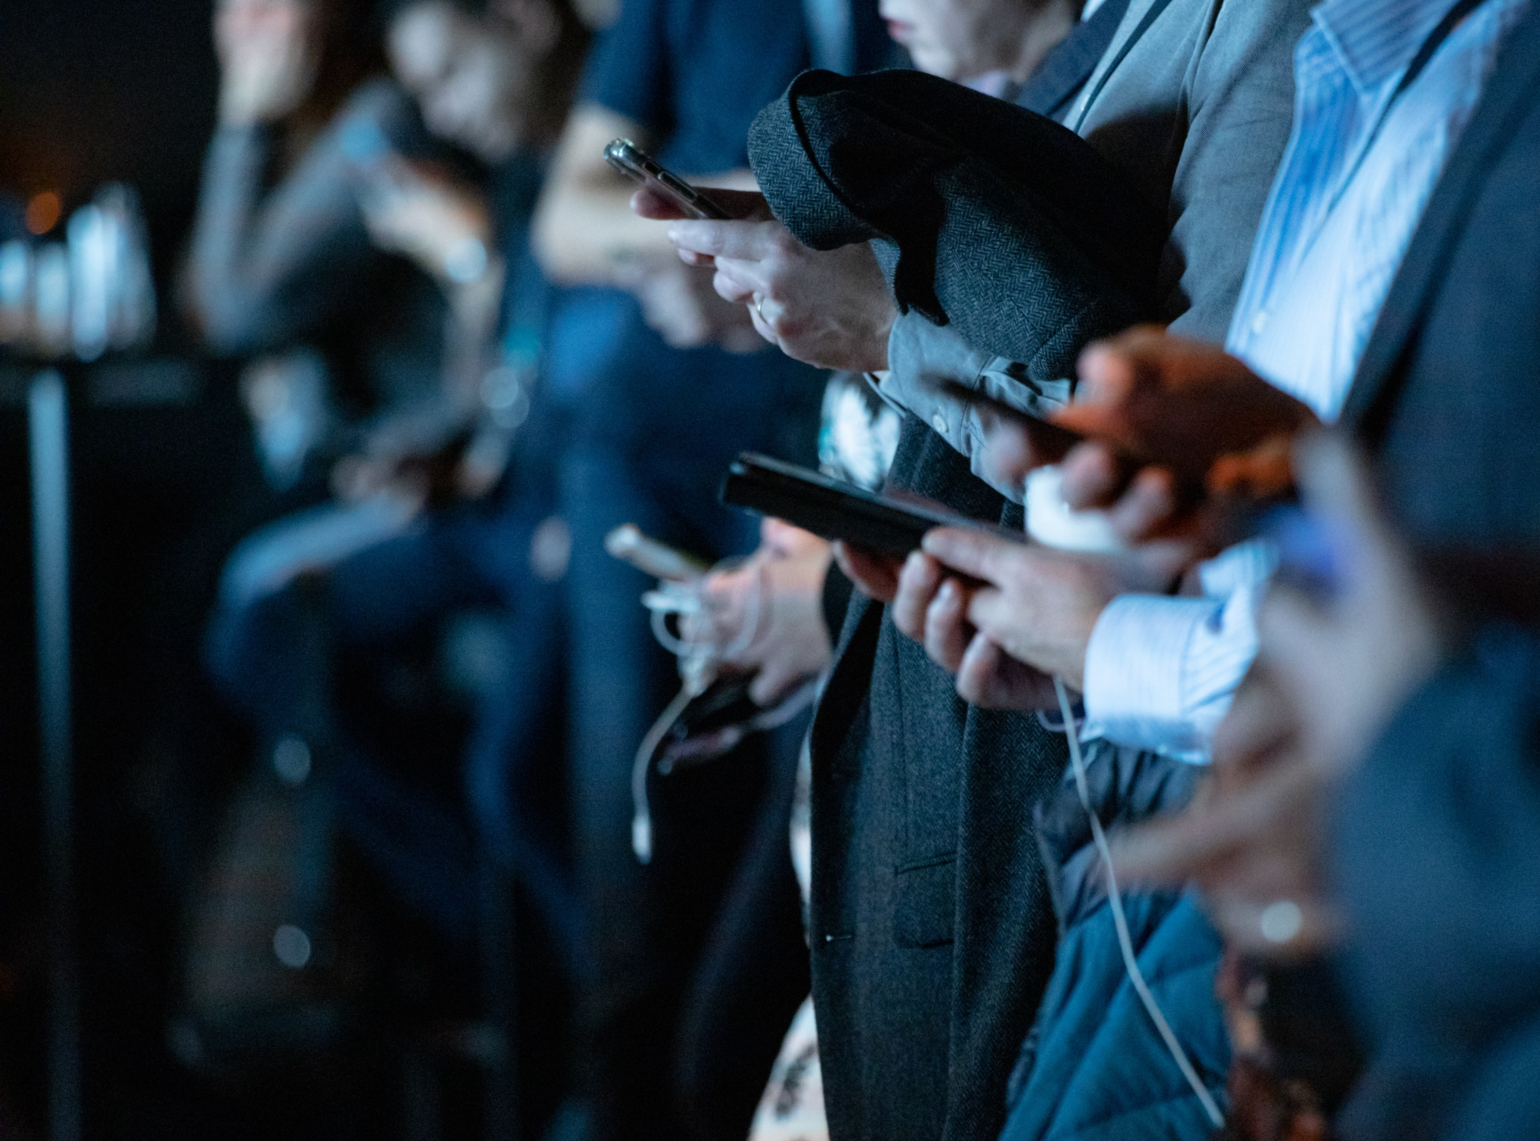
The Evolution
of
Communication
Contents
Methodology
Range
Ancient Age
Cave paintings, smoke signal, visual signals
Analog Age
Newspaper, radio, telegraphs
Digital Age
Email, SNS, Texts
Notes:
camilo jimenez
https://unsplash.com/photos/qZenO_gQ7QA
https://www.mobilecon2012.com/the-evolution-of-communication-through-the-centuries/

Slide 3
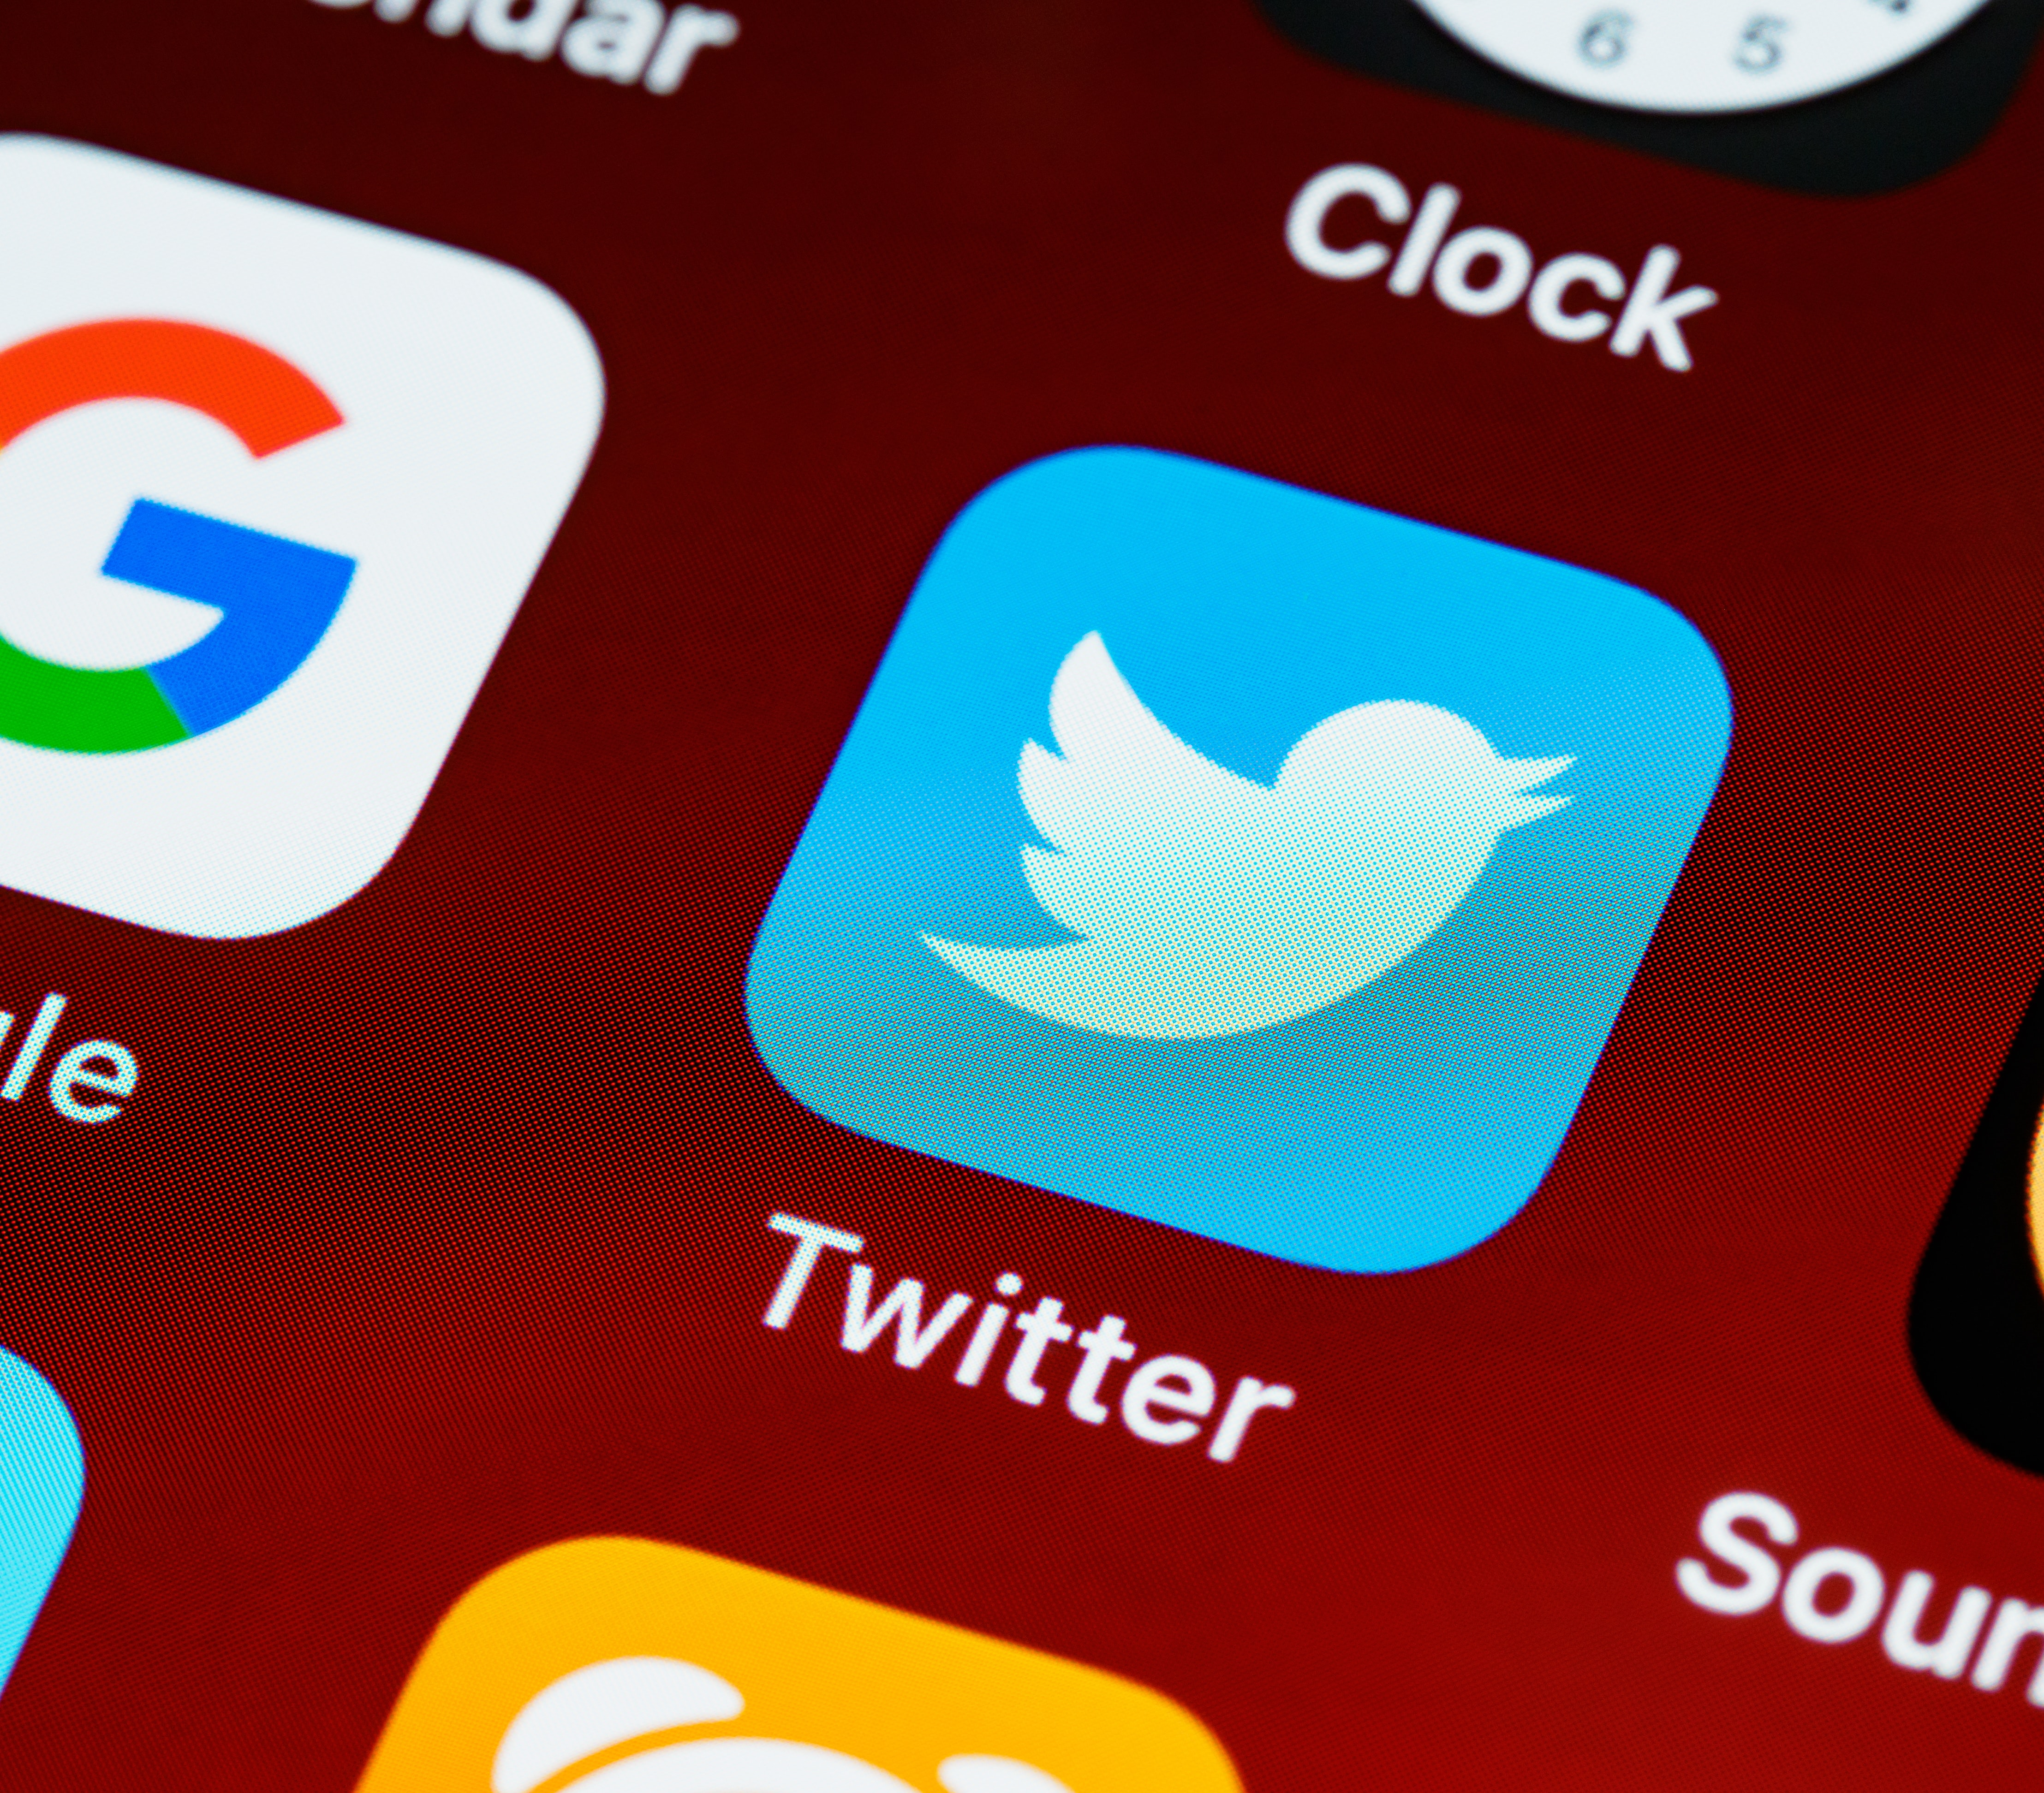
Twitter
Twitter
Importance of water
Source of life
Improve life quality
Increase school attendance
Empowers families
24 million people without basic access to safe water
Numerous organizations have been working to provide safe and accessible water
145 million daily users
22% of Americans are on Twitter
500 million tweets sent each day
65.8% of US companies use Twitter for marketing
80% of Twitter users have mentioned a brand in a tweet
77% of Twitter users feel more positive when their tweet has been replied to.
Notes:
https://unsplash.com/photos/ulRlAm1ITMU

Slide 4
Goal
Create a model that can

Slide 5
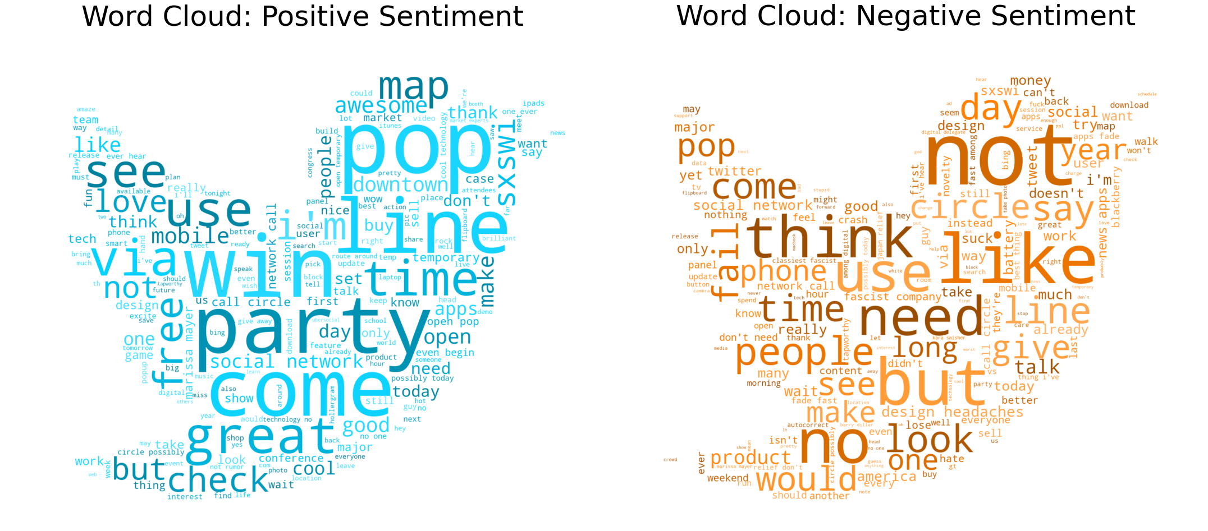
EDA: Positive and Negative Sentiments
Notes:
image source: https://blog.mellanox.com/2019/05/an-out-of-band-malware-detection-with-mellanox-bluefield/

Slide 6
Conclusion
Our final models can
Predict with ~80% recall (Random Forest – 4 1st layers)
Features correlated with water wells in need of maintenance
[1] Installer: Government and RWE installers
[2] Water quantity: Dry and unknown quantities
[3] Funder: Government and Norad funders
[4] Extraction type: other than gravity type
[5] Payment: no payment for usage
[6] Management: VWC management
[7] Neighboring: highly dense non-functioning wells area

Slide 7
Future Direction
Further hyperparameter tuning can be done for each model used
Different combinations of ensemble models can be tested
Different methods of dealing with class imbalance can be used
under sampling
different class weights
Cost function for
[1] wrongly identifying functioning wells as need repairing wells and
[2] not being able to identify wells in need of repairing
would improve the model to minimize both economical and sociological cost.

Slide 8
Thank you for listening

Slide 9
Appendix

